Slide 1
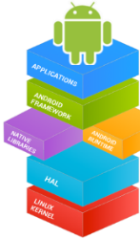



Mobile Application Development (COS7025-B) Designing Mobile Apps using Android Working with Databases
Karim Hammoud Sadik
Lecture #7
Android Studio

Slide 2
Contents
Understand the basics of SQLite storage
Understand how to use SQLite in your own applications
Understand the querying and other data management support in SQLite
Understand the basic of Firebase Database
Understand the basic of Android File System

Slide 3
What is SQLite?
Embedded SQL engine
Not a client/server architecture (as opposed to most SQL-based engines)
Accessed via function calls from the application
Process that wants to access the database reads and writes directly from the database files on a disk
What are the advantages?
No separate server process to install, setup, configure etc.
SQLite is a tiny powerful database engine. Besides Android, it can be found in:
Apple iPhone
Symbian phones
Mozilla Firefox
Skype
PHP
Adobe AIR
Mac OS X
Solaris
many others...

Slide 4
SQLite – Zero configuration
Does not need to be installed
No setup procedure
No server process that needs to be started, stopped etc.
No configuration files
Advantages of SQLite
It's free.
It's small. The current version is about 150KB.
It requires no setup or administration. There is no server, no config file, and no need for a database administrator.
A SQLite database is just a file. You can take that file, move it around, and even copy it to another system.
Android stores it in the /data/data/packagename/databases directory.

Slide 5
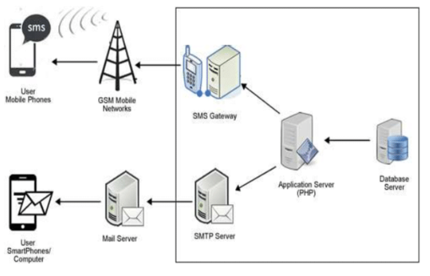
What is a Database Server
Is a server which receives requests from clients requiring access to data in a database (this could be read or write)

Slide 6
Relational Databases
Everything organised into tables
Book_Title
Authors
Published date
Price
Books:
Relational Databases
BEA
2000.5
12.35
Java
EFH
2001.2
16.50
Readers:
Name
Address
Telephone
Eric
Leeds
0113-
Peter
Bradford
01274-

Slide 7
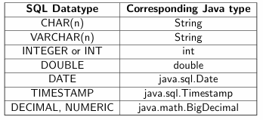
Accessing Databases
SQL (Structured Query Language) is used.
The main variations are:
Transact SQL (T-SQL). Used by Microsoft SQL Server and Sybase. The two have very few differences.
PL-SQL. Used in Oracle.
ANSI SQL. Parts of it adopted by commercial and public domain products
SQL Datatypes

Slide 8
SQL Statements
Four main categories:
CREATE and INSERT (create a table, put values into it)
SELECT (query the database about data matching certain criteria)
UPDATE (to change the values in existing rows)
DELETE and DROP (to delete speci c rows or tables)
The CREATE Statement
Example:
CREATE TABLE Person ( name VARCHAR(100), age INTEGER, address VARCHAR(100))
Syntax:
CREATE TABLE tablename( colName dataType
)

Slide 9
SQL Statements
The INSERT Statement
Syntax:
INSERT INTO tablename (colName1, colName2, colName3 ...)
VALUES (value1, value2, value3, ...)
Example:
INSERT INTO Person (name, age, address)
VALUES ( John Smith, 26, London), ( Tom Bubble, 34, York),
The SELECT Statement
Example:
SELECT Person.name, Person.address, ListensTo.music_group_name
FROM Person, ListensTo
WHERE ListensTo.music-group_name IN (Beatles, Popstars) AND Person.name = ListensTo.person_name AND Person.address = London
Syntax:
SELECT Name1, Name2, Name3 ...
FROM tablename1, tablename2, ...
WHERE conditions
ORDER BY colNames

Slide 10
SQL Statements
The UPDATE Statement
Syntax:
UPDATE tablename
SET colName1=value1, colName2=value2 ... WHERE colNamei someOperator valuei
Example:
UPDATE Person
SET age = 25, address=‘Bradford’
WHERE name = ‘John Smith’
The DELETE and DROP Statements
Example:
DELETE FROM Person
WHERE name = ‘John Smith’
The rows corresponding to John Smith are deleted.
Syntax:
DELETE FROM tablename
WHERE colNamei someoperator valuei

Slide 11
An example of Creating a Table in SQLite
create table mytable ( _id integer primary key auto-increment,
name text,
phone text );
One of the columns is designated as the PRIMARY KEY, a number that uniquely identifies the row.
AUTO-INCREMENT means that the database will add 1 to the key for every record to make sure its unique.
By convention, the first column is always called _id.
Unlike most databases, in SQLite the column types are just hints. If you try to store a string in an integer column, or vice versa, it will just work with no complaints

Slide 12
Building the SQLite Database
Check if the database exists
If it does not, create it, create the tables and populate them with initial data
If it does, open it, check what version it is.
If the database is an old version, upgrade it to a newer version.
The above steps are facilitated by using the SQLiteOpenHelper class.
Class = android.database.sqlite
Contains the SQLite database management classes that an application would use to manage its own private database.
Some of the classes that you will use regularly:
SQLiteCursor - A Cursor implementation that exposes results from a query on a SQLiteDatabase.
SQLiteDatabase - Exposes methods to manage a SQLite database.
SQLiteOpenHelper - A helper class to manage database creation and version management.

Slide 13
Building the SQLite Database
Class = android.database.sqlite
Contains the methods for:
creating, opening, closing, inserting, updating, deleting and querying an SQLite database
These methods are similar to JDBC but more method oriented than what we see with JDBC (remember there is not a RDBMS server running)
Bookmark this:
https://developer.android.com/reference/android/database/Cursor.html
https://developer.android.com/reference/android/database/package-summary.html

Slide 14
Building the SQLite Database
Option 1: openOrCreateDatabase( )
This method will open an existing database or create one in the application data area
import android.database.sqlite.SQLiteDatabase;
SQLiteDatabase db;
//first param = name of database
//second param = indicates that the database file can only be accessed by //the calling application or all applications sharing the same user ID
db=openOrCreateDatabase("StudentDB", Context.MODE_PRIVATE,);
//execSQL executes any sql command
db.execSQL("CREATE TABLE IF NOT EXISTS student(uob_no VARCHAR,name VARCHAR,marks VARCHAR);");

Slide 15
Building the SQLite Database
Option 2: SQLiteOpenHelper
Public class DatabaseOpenHelper extends SQLiteOpenHelper {
final private static String CREATE_DB = "CREATE TABLE IF NOT EXISTS student (uob_no VARCHAR,name VARCHAR,marks VARCHAR)";
//”student” = name of the database; 1 = version of the db;
public DatabaseOpenHelper (Context context) {
super(context, "student", null, 1);
}
@Override
public void onCreate(SQLiteDatabase db) {
db.execSQL(CREATE_DB);
}
}

Slide 16
Building the SQLite Database
Option 2: SQLiteOpenHelper
Then your controller class will have..
DatabaseOpenHelper sqLiteProjHelper = new DatabaseOpenHelper(this);
db = sqLiteProjHelper.getWritableDatabase();

Slide 17
Creating Tables in SQLite
Create a static string containing the SQLite CREATE statement, use the execSQL( ) method to execute it.
String query = "CREATE TABLE IF NOT EXISTS student (uob_no VARCHAR,name VARCHAR,marks VARCHAR)";
String query = "CREAT TABLE authors (id INTEGER PRIMARY KEY AUTOINCREMENT,
fname TEXT,
lname TEXT);
myDatabase.execSQL(query);
https://www.youtube.com/watch?v=312RhjfetP8

Slide 18
Creating Tables in SQLite
insert( )
long insert(String table, String nullColumnHack, ContentValues values)
import android.content.ContentValues;
ContentValues values = new ContentValues( );
values.put(”id" , ”1");
values.put(”name" , ”Mike");
myDatabase.insert(”student" , "" , values);
Option 1
Option 2
db.execSQL("INSERT INTO student VALUES (‘1’,’Mike’, ‘100’);

Slide 19
Creating Tables in SQLite
update( )
int update(String table, ContentValues values, String whereClause, String[ ] whereArgs)
Option 1
ContentValues values = new ContentValues();
values.put(”name" , “Mark”);
myDatabase.update(”student" , values , {”uob_no=?" , “10” } );
Option 2
db.execSQL("UPDATE student SET name= “Mark WHERE uob_no=‘10’);

Slide 20
Creating Tables in SQLite
delete( )
int delete(String table, String whereClause, String[] whereArgs)
Option 1
myDatabase.delete(”student" , “WHERE”, ”uob_no=?" , “10”) ;
Option 2
db.execSQL("DELETE FROM student WHERE uob_no=“10”)

Slide 21
SQL Query
Cursor c= db.rawQuery("SELECT * FROM student”);
Cursor c= db.rawQuery("SELECT * FROM student WHERE uob_no=“1111”);

Slide 22
Few useful methods of Cursor class
Cursor c;
If (c.getCount()==0) { //get the count of rows returned for a query }
while (c.moveToNext()) { //go through all the returned rows for a query }
If (c.moveToNext()) { //does it at least have one record returned? }

Slide 23
How to create an index?
db.execSQL("CREATE TABLE IF NOT EXISTS student(uob_no VARCHAR, name VARCHAR, marks VARCHAR);");
To:
db.execSQL("CREATE TABLE IF NOT EXISTS student (id INTEGER PRIMARY KEY, uob_no VARCHAR,name VARCHAR,marks VARCHAR);");
db.execSQL("CREATE INDEX studentindex1 ON student (name);");
db.execSQL("CREATE INDEX studentindex2 ON student (uob_no);");

Slide 24
Use Firebase to store and share data
Firebase is a real time database which allows to store tree of lists of objects. It allows to synchronize data between different devices. It is a NoSQL JSON database.
You can find it under: https://console.firebase.google.com/
Firebase Realtime Database
● Connected apps share data
● Hosted in the cloud
● Data is stored as JSON
● Data is synchronized in realtime to every connected client
Configure firebase
Logon to https://console.firebase.google.com/ and press Add Firebase to your Android app.

Slide 25
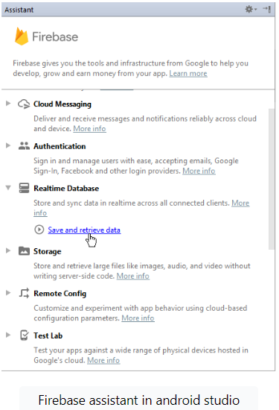
How to integrate the Firebase database in Mobile App
Use Firebase as an API in a mobile or web application.
Must properly integrate this database into our project by syncing the appropriate libraries and dependencies, available on Google’s official documentation site for Firebase, mentioned here.
Step 1. Go to Android Studio. If we don’t already have it, we must download and install it first. Create a new project.
Step 2. Once your empty project is fully loaded and Gradle files are synced properly, go to tools -> Firebase. Once a new window opens, locate and select Save and retrieve under the Realtime Database section.

Slide 26
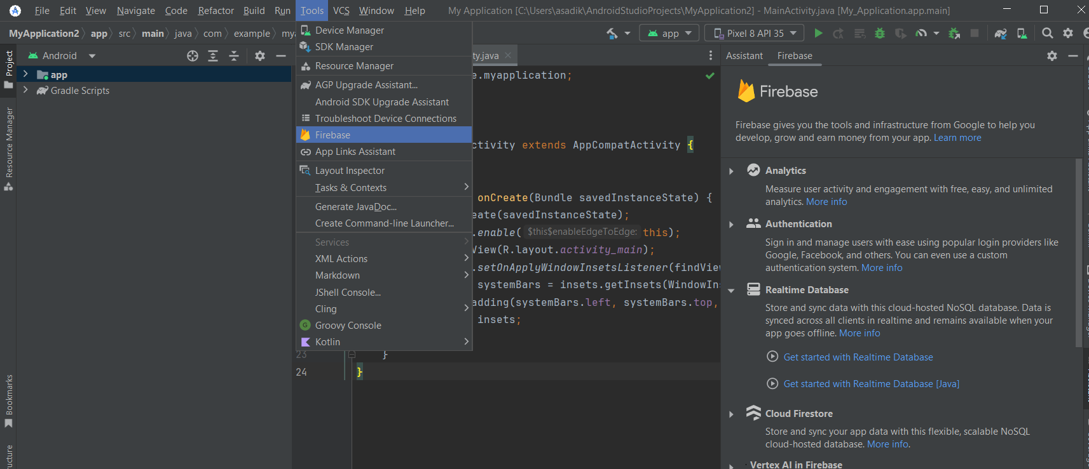
How to integrate the Firebase database in Mobile App

Slide 27
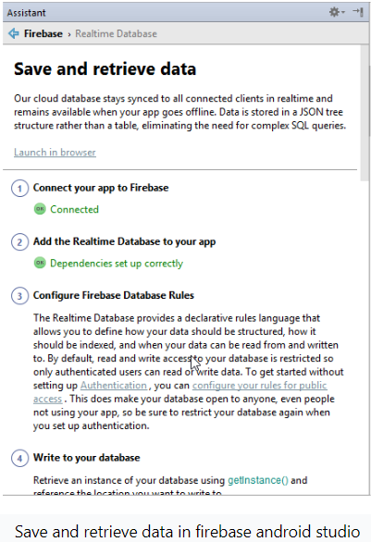
How to integrate the Firebase database in Mobile App
Step 3. Connect our Firebase project and move to set our dependencies.
Now apply CRUD operations using Firebase.

Slide 28
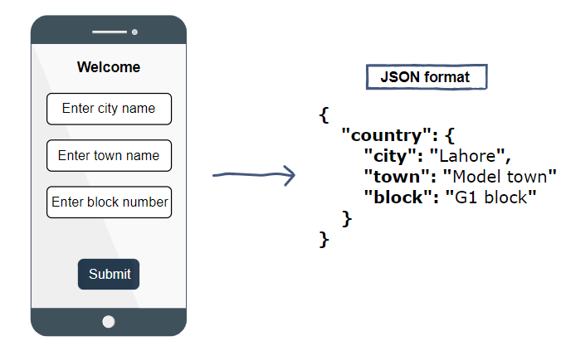
What does the data in Firebase look like?
Firebase stores the real-time data in a JSON format. The format is described below.
Suppose we have an android application that asks the user for some input. Firebase stores that input in real-time and presents it in JSON format.
We can view this type of data on web browsers by locating the specific URL of the Firebase application

Slide 29
To see example on how to use Firebase database with Android using Java
Please see this link
https://firebase.google.com/docs/auth/android/start
https://www.tutorialspoint.com/android/android_php_mysql.htm

Slide 30
Android File System
● External storage -- Public directories
● Not always available, can be removed
● Uses device's file system or physically external storage like SD (Secure Digital) card
● World-readable, so any app can read
● On uninstall, system does not remove files private to app
● Internal storage -- Private directories for just your app
● Always available
● Uses device's filesystem
● Only your app can access files, unless explicitly set to be readable or writable
● On app uninstall, system removes all app's files from internal storage
Apps can browse the directory structure
Structure and operations similar to Linux and java.io

Slide 31
When to use internal/external storage
Internal is best when
● you want to be sure that neither the user nor other apps can access your files
External is best for files that
● don't require access restrictions
● you want to share with other apps
● you allow the user to access with a computer

Slide 32
Android File System
Internal Storage
● Uses private directories just for your app
● App always has permission to read/write
● Permanent storage directory—getFilesDir()
● Temporary storage directory—getCacheDir()
Creating a file
File xfile = new File(context.getFilesDir(), filename);
Use standard java.io file operators or streams to interact with files

Slide 33
Android File System
External Storage
● On device or SD card
● Set permissions in Android Manifest
○ Write permission includes read permission
<uses-permission
android:name="android.permission.WRITE_EXTERNAL_STORAGE" />
<uses-permission
android:name="android.permission.READ_EXTERNAL_STORAGE" />
Always check availability of storage
public boolean isExternalStorageWritable() {
String state = Environment.getExternalStorageState();
if (Environment.MEDIA_MOUNTED.equals(state)) {
return true;
}
return false;
}

Slide 34
Example external public directories
● DIRECTORY_ALARMS and DIRECTORY_RINGTONES
For audio files to use as alarms and ringtones
● DIRECTORY_DOCUMENTS
For documents that have been created by the user
● DIRECTORY_DOWNLOADS
For files that have been downloaded by the user
developer.android.com/reference/android/os/Environment.html

Slide 35
Accessing public external directories
1. Get a path getExternalStoragePublicDirectory()
2. Create file
File path = Environment.getExternalStoragePublicDirectory(
Environment.DIRECTORY_PICTURES);
File file = new File(path, "DemoPicture.jpg");

Slide 36
Any Questions?

